Slide 1

FSM for Robot Target Search and Retrieval under Semi-constructed Environment
Xihan Ma, Honglin Sun, Enwei Xu, Song Cui, Boqun Yin, Mariam Faied
University of Detroit Mercy
Dept. of Electrical and Computer Engineering and Computer Science
ICMA, Oct. 14, 2020

Slide 2
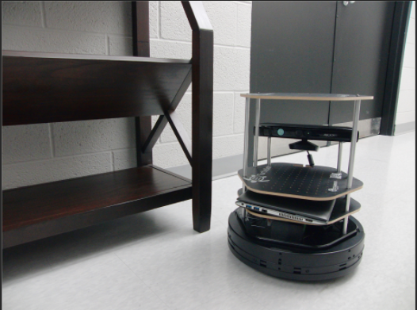
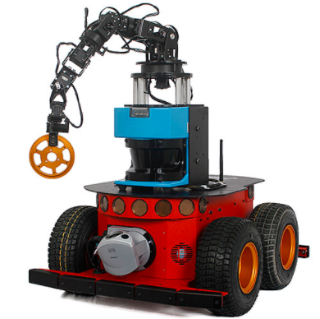
Autonomous Mobile Robots
Working Scenarios
Repeatability, uncertainty, high risk
Unknown/semi-unknown environment
Multi-task Mobile Robots
Exploration
Navigation
Object recognition
……
A behavior switching mechanism
TurtleBot2
Pioneer P3-AT

Slide 3
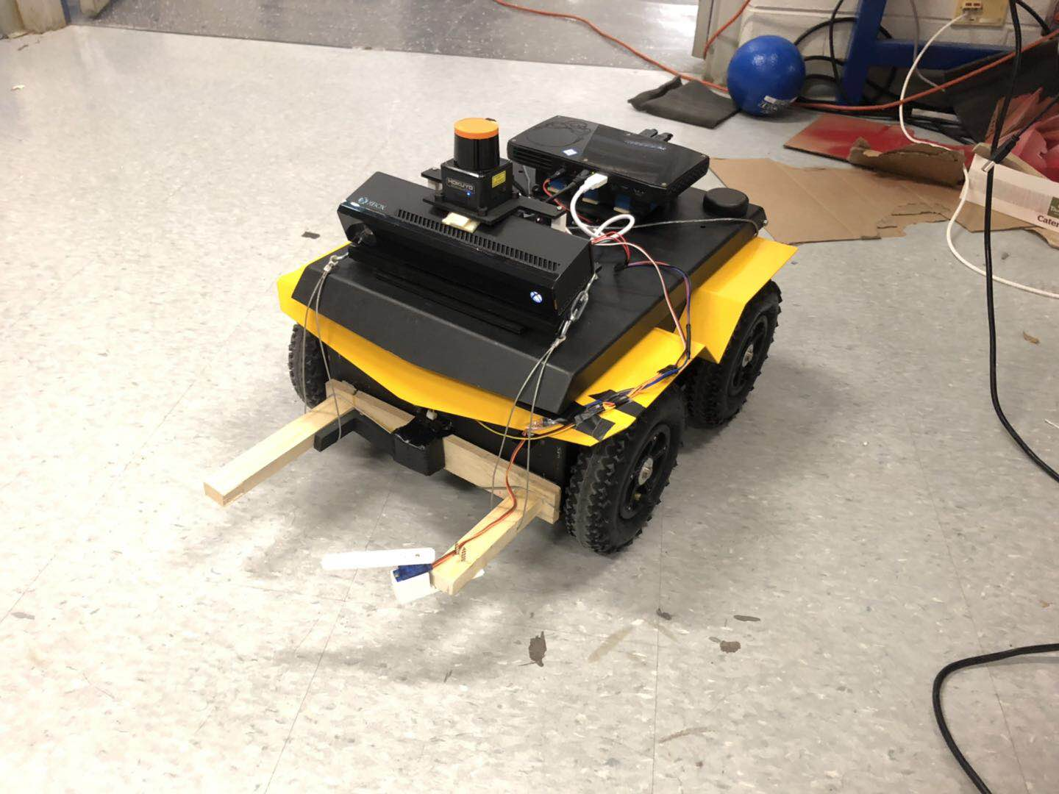
Hardware Setup
Clearpath Jackal UGV
Intel NUC
Hokuyo LiDAR
Arduino
Kinect camera
SHARP distance sensor
Servo motor

Slide 4
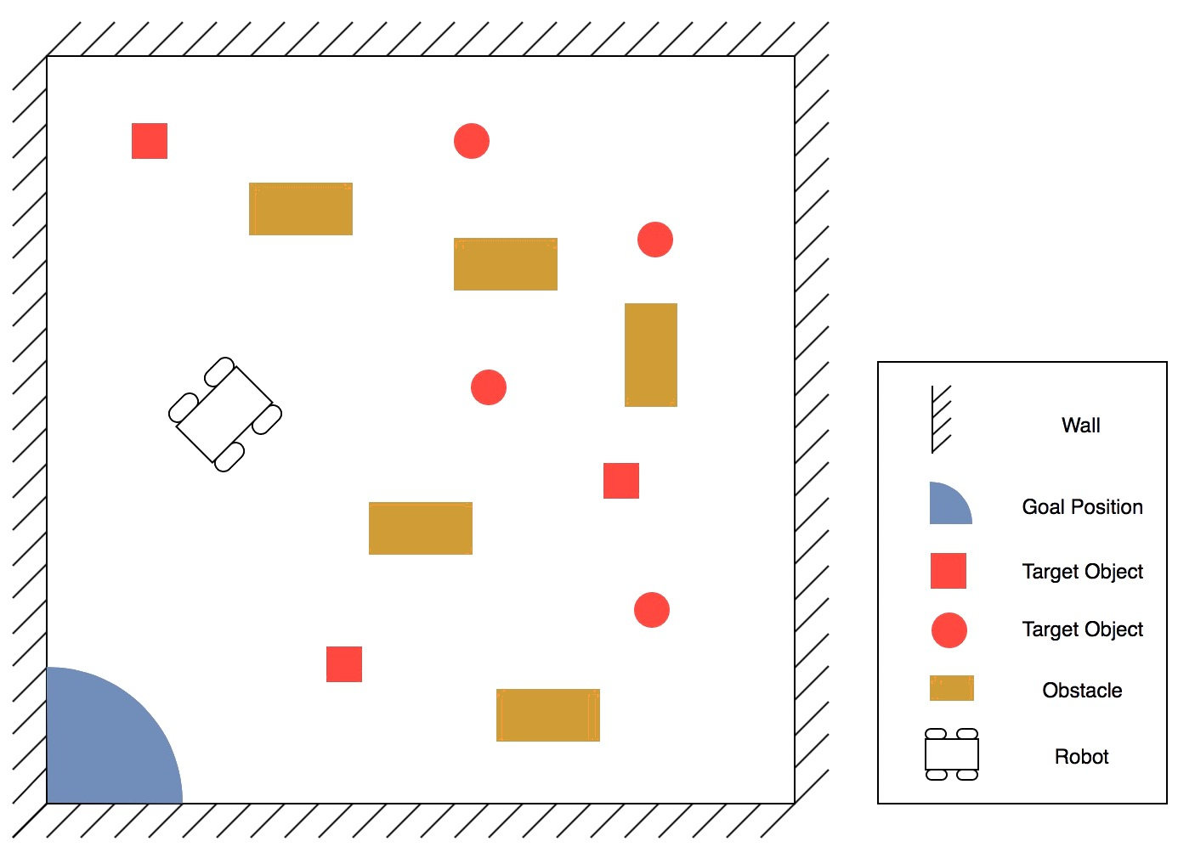
Hardware Setup
Field Setting
Enclosed field
Box and ball shaped target objects in two different colors
Obstacles
Behaviors
Exploration
Object gripping
Navigation

Slide 5
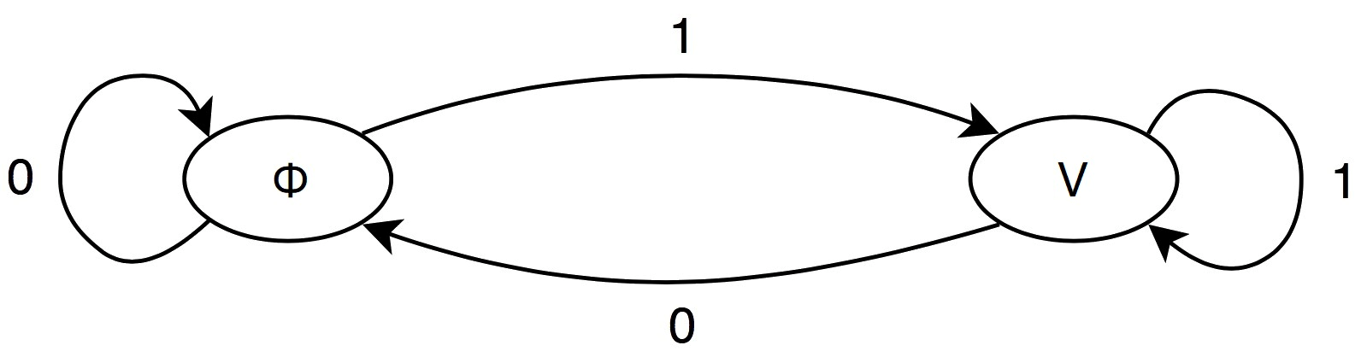
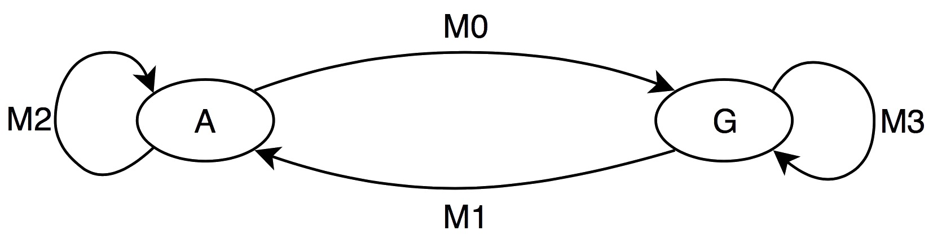
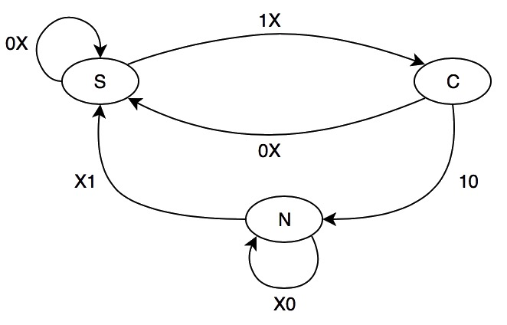
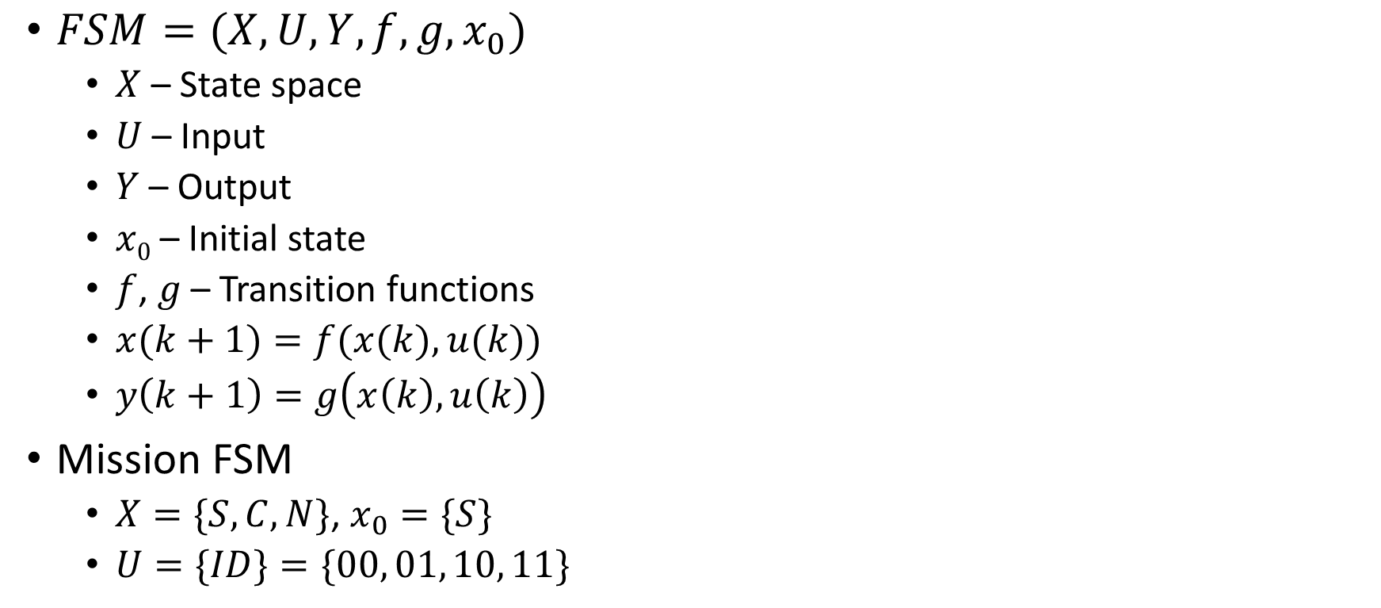
Finite State Machine Modeling
$FSM=(X,U, Y, f, g, x_{0})$
$X$ – State space
$U$ – Input
$Y$ – Output
$x0$ – Initial state
$f$, $g$ – Transition functions
$x(k+1)=f(x(k), u(k))$
$y\left(k+1\right)=g\left(x\left(k\right), u\left(k\right)\right)$
Mission FSM
$X=\{S, C, N\}$, $x_{0}=\{S\}$
$U=\{ID\}=\{00, 01, 10, 11\}$
Sub-FSM
Transition Graph of Mission FSM

Slide 6
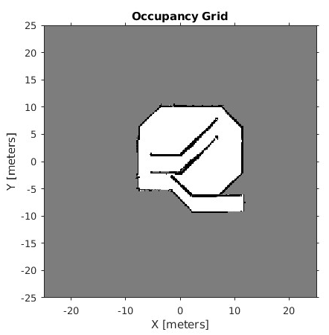
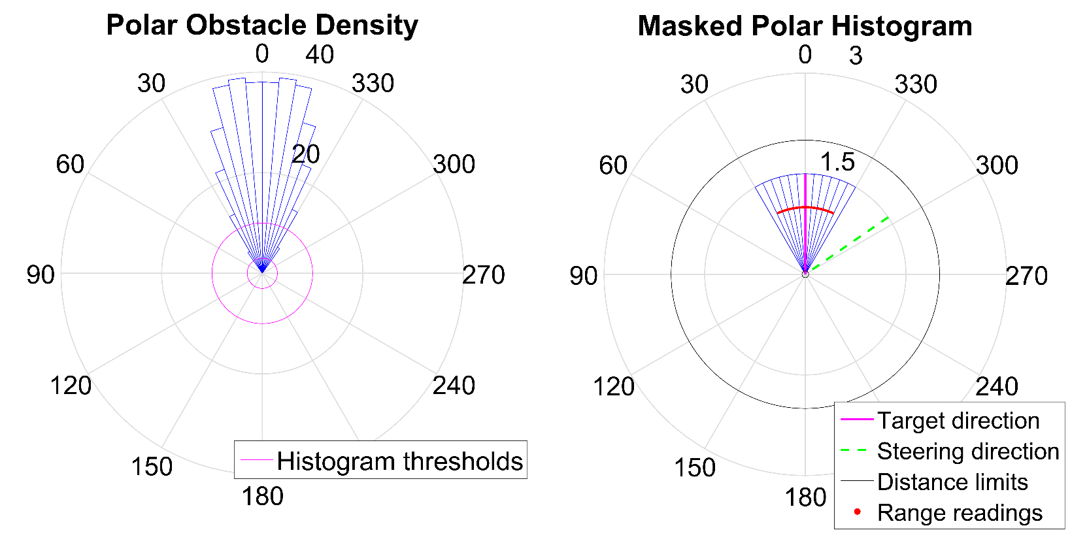
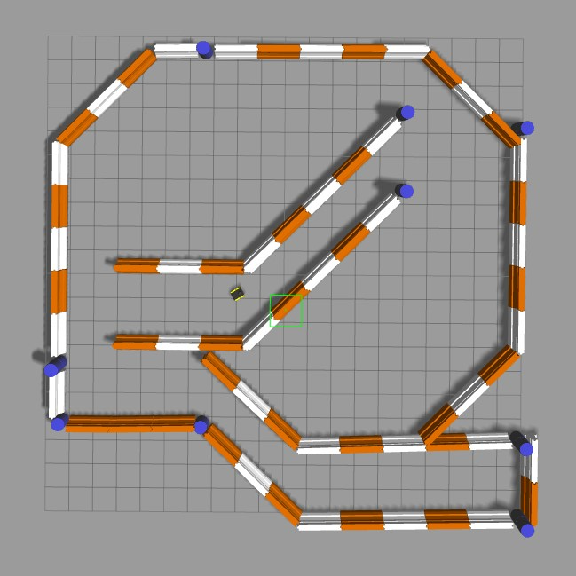

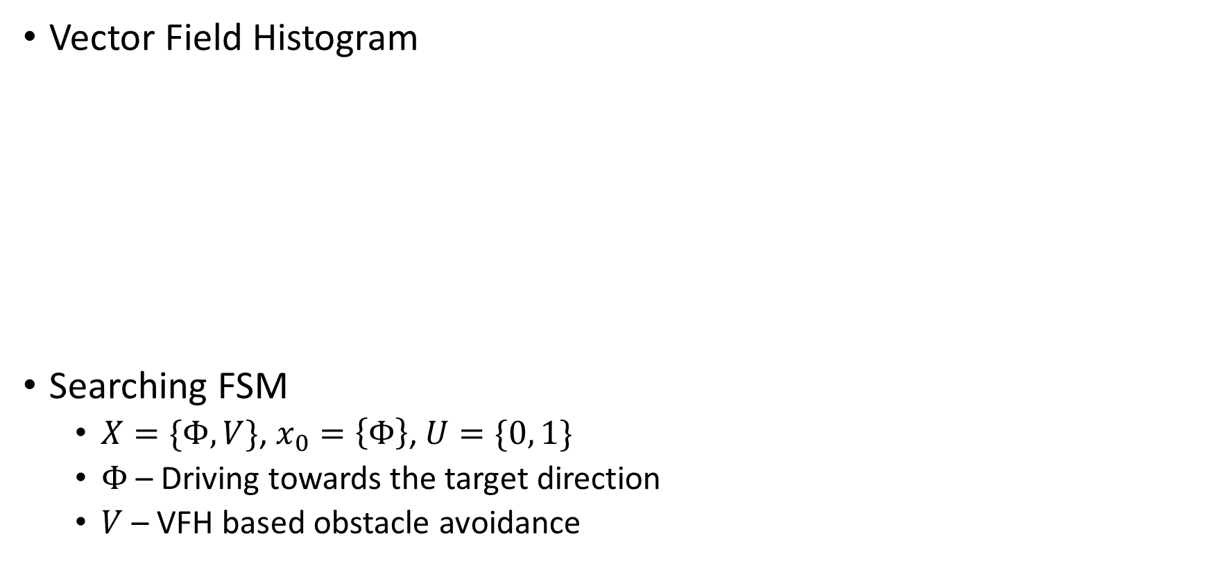
Searching Behavior
S
↕ C
↓
N
Vector Field Histogram
Searching FSM
$X=\{Φ, V\}$, $x_{0}=\left\{Φ\right\}$, $U=\{0, 1\}$
$Φ$ – Driving towards the target direction
$V$ – VFH based obstacle avoidance
https://www.mathworks.com/help/nav/ug/vector-field-histograms.html

Slide 7
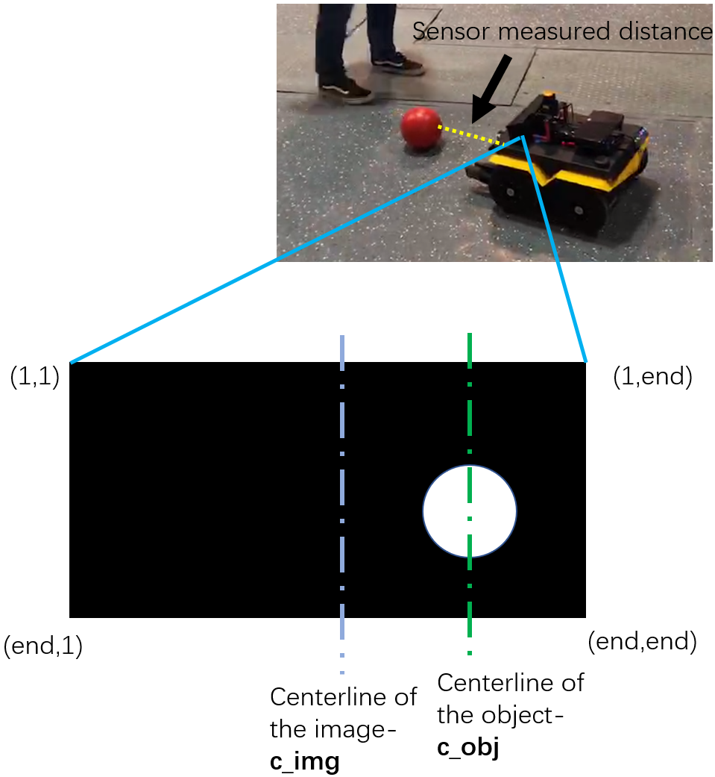
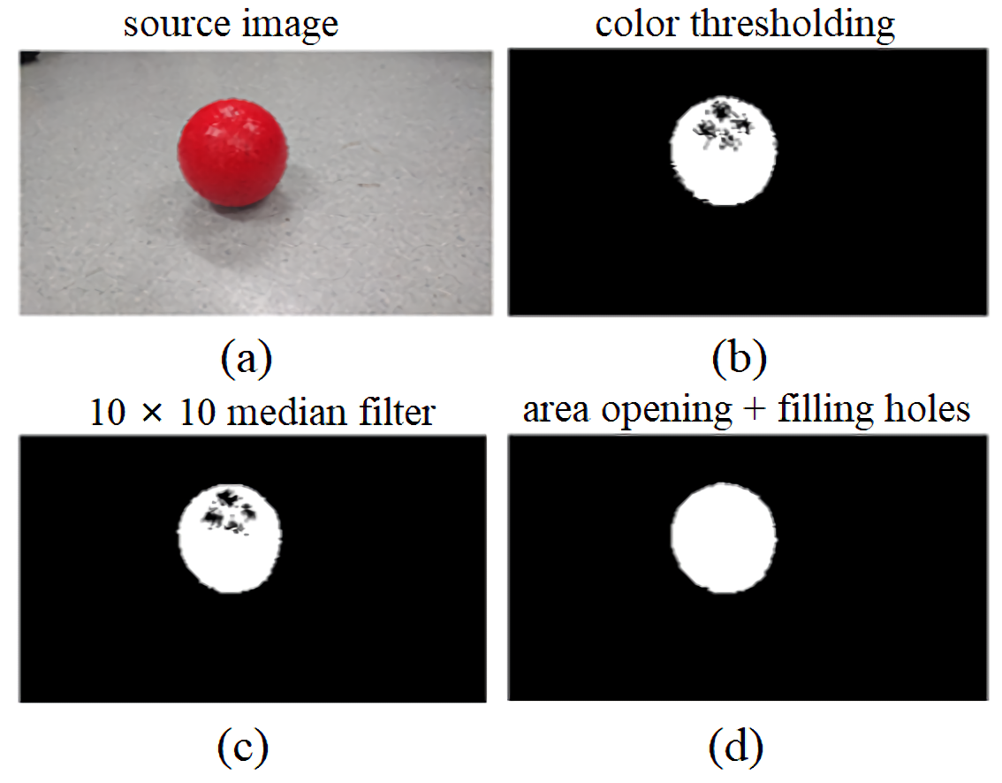
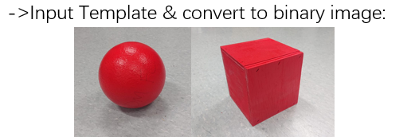
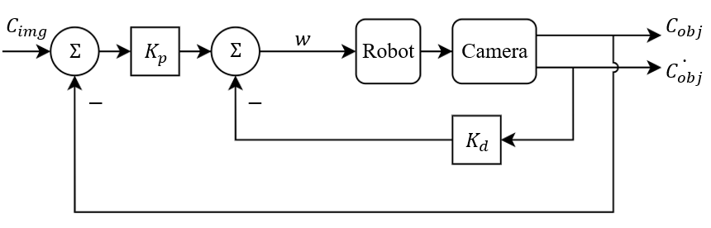
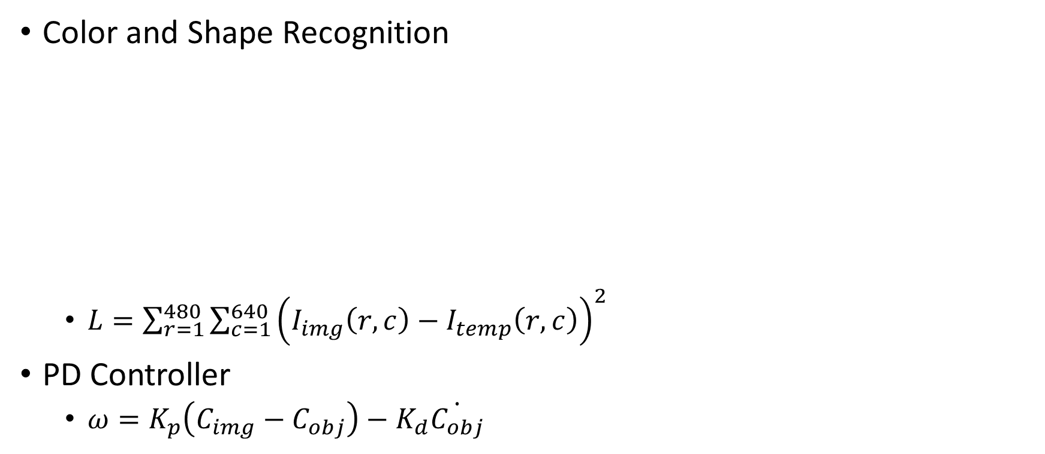
Object Tracking
S
↕ C
↓
N
Color and Shape Recognition
$L=\sum_{r=1}^{480}{\sum_{c=1}^{640}{{\left(I_{img}\left(r,c\right)−I_{temp}\left(r,c\right)\right)}^{2}}}$
PD Controller
$ω=K_{p}\left(C_{img}−C_{obj}\right)−K_{d}\dot{C_{obj}}$

Slide 8
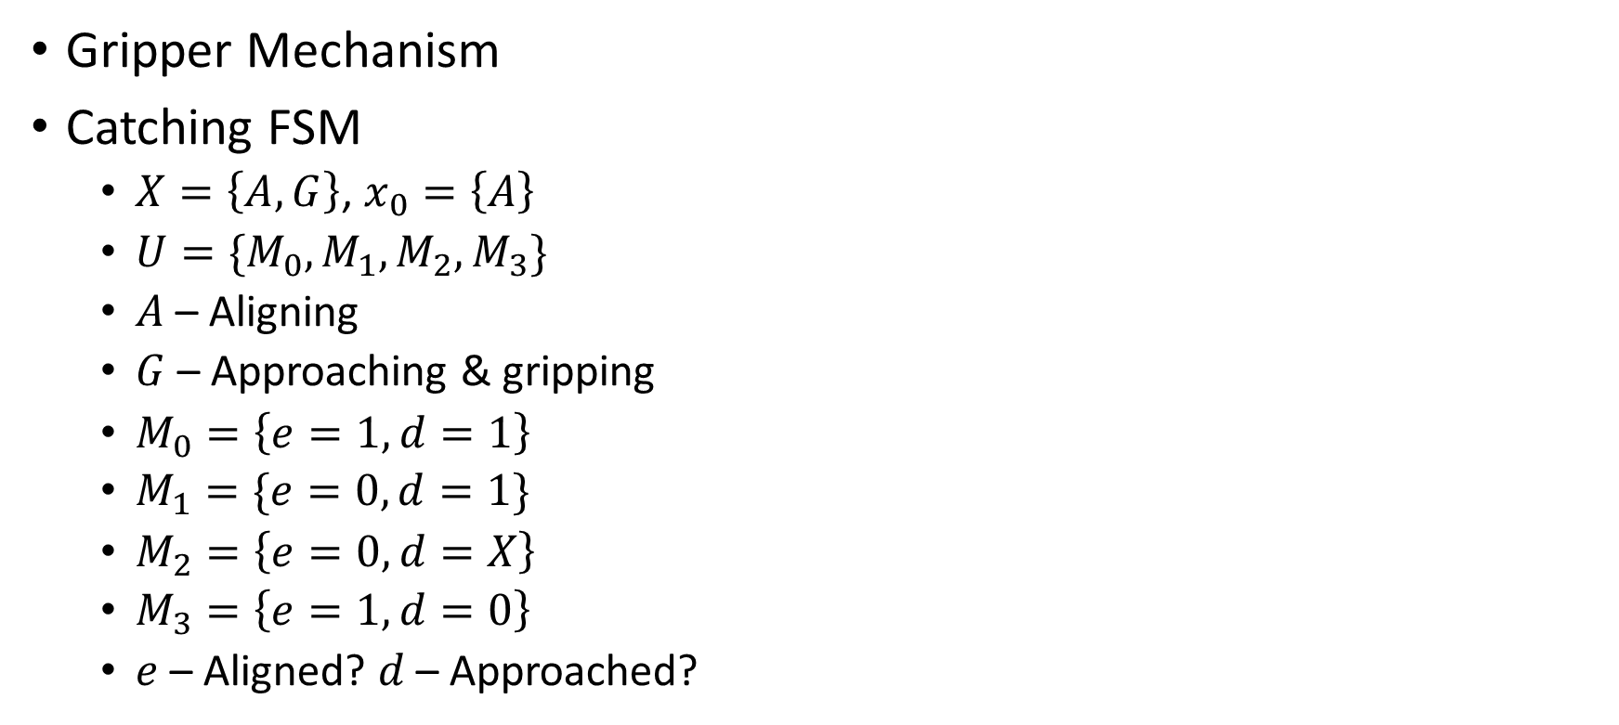
Catching Behavior
S
↕C
↓
N
Gripper Mechanism
Catching FSM
$X=\left\{A,G\right\}$, $x_{0}=\left\{A\right\}$
$U=\{M_{0},M_{1},M_{2},M_{3}\}$
$A$ – Aligning
$G$ – Approaching & gripping
$M_{0}=\left\{e=1, d=1\right\}$
$M_{1}=\{e=0, d=1\}$
$M_{2}=\left\{e=0, d=X\right\}$
$M_{3}=\left\{e=1, d=0\right\}$
$e$ – Aligned? $d$ – Approached?
Distance sensor
Wooden arm
Servo motor with rotating bar

Slide 9
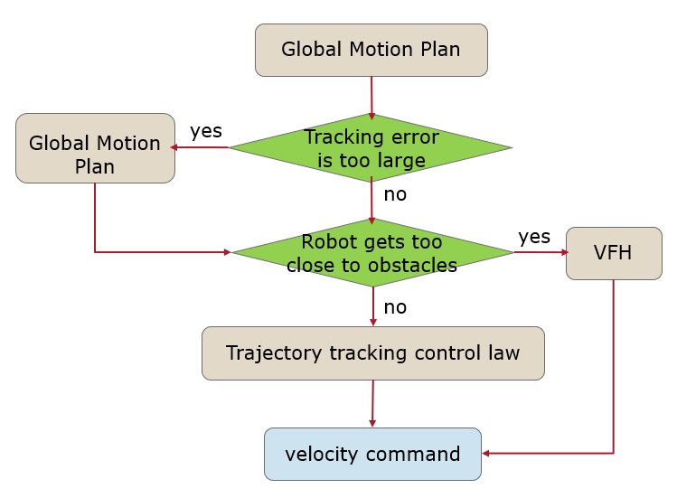
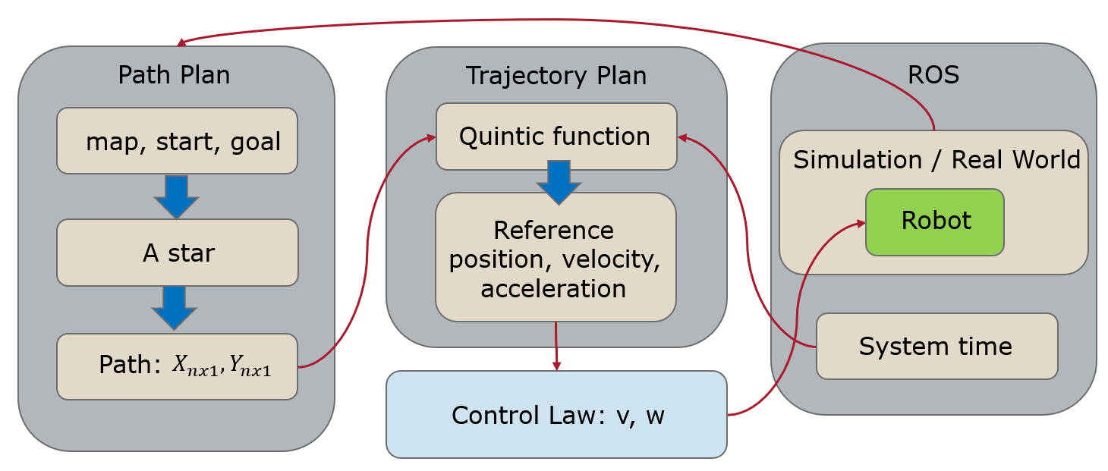
Navigation Behavior
S
↕ C
↓
N
Navigation Architecture & Execution Flowchart
X. Ma, H. Sun, E. Xu, S. Cui, B. Yin and M. Faied, "Fast Adaptable Mobile Robot Navigation in Dynamic Environment,"
2020 5th International Conference on Advanced Robotics and Mechatronics (ICARM), Shenzhen, China, 2020, pp. 347-352,
doi: 10.1109/ICARM49381.2020.9195364.

Slide 10
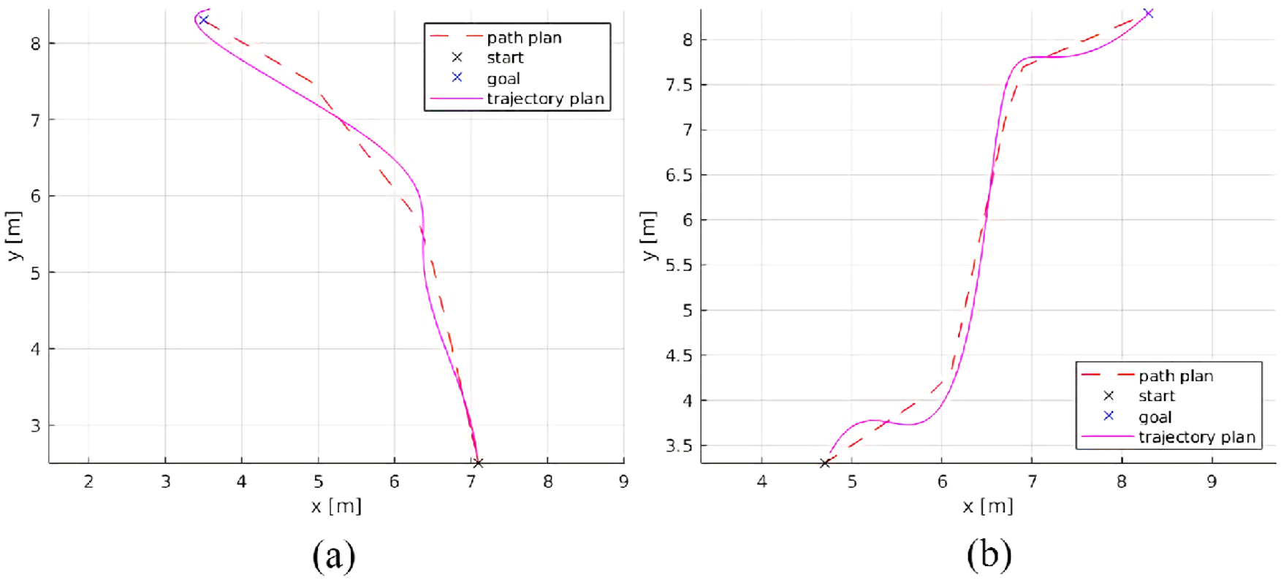
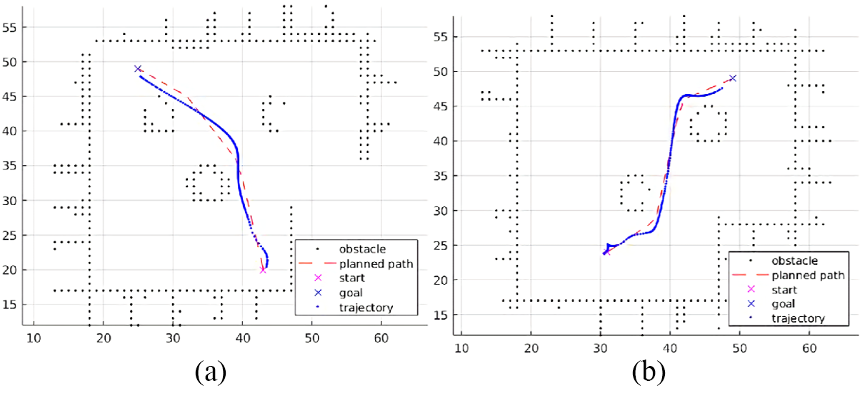
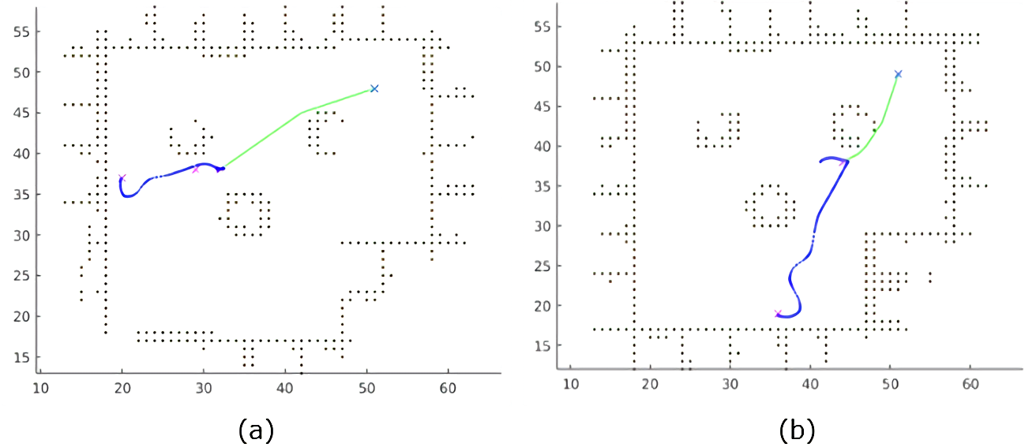
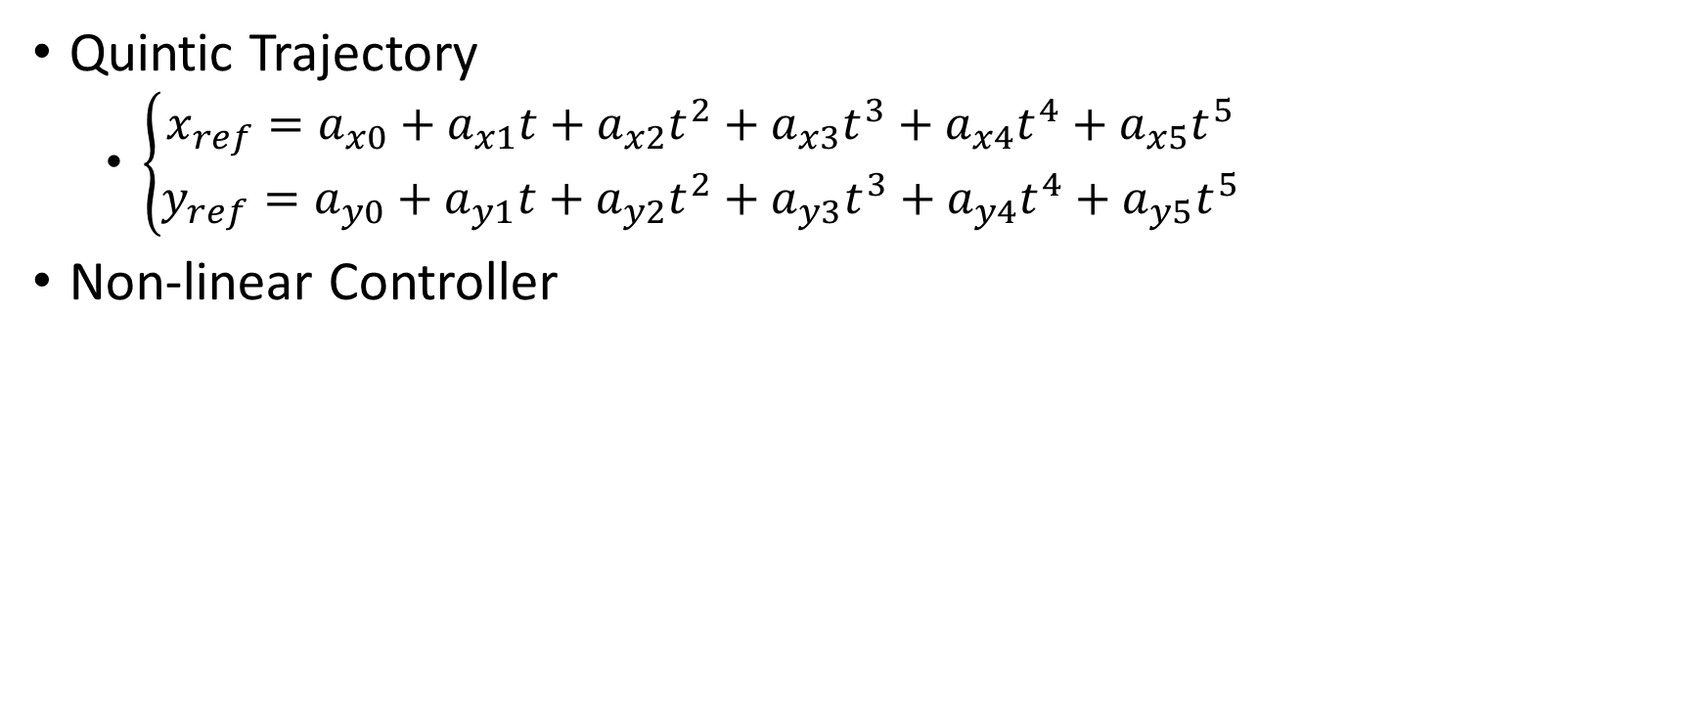
Navigation Behavior
S
↕ C
↓
N
Quintic Trajectory
$\left\{\begin{aligned}x_{ref}=a_{x0}+a_{x1}t+a_{x2}t^{2}+a_{x3}t^{3}+a_{x4}t^{4}+a_{x5}t^{5} \\ y_{ref}=a_{y0}+a_{y1}t+a_{y2}t^{2}+a_{y3}t^{3}+a_{y4}t^{4}+a_{y5}t^{5}\end{aligned}\right.$
Non-linear Controller

Slide 11
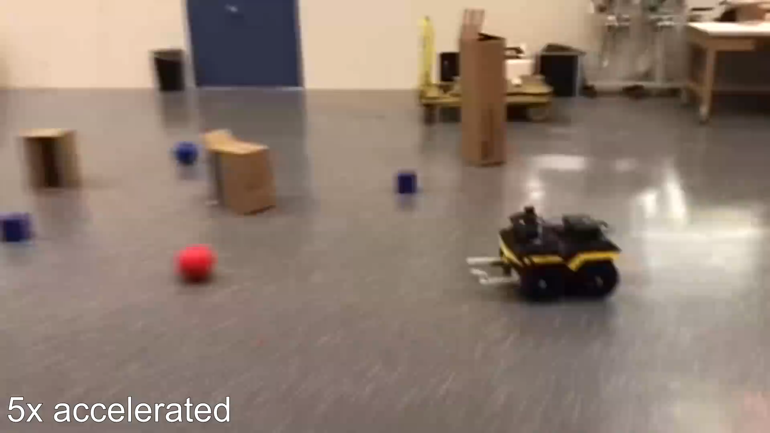
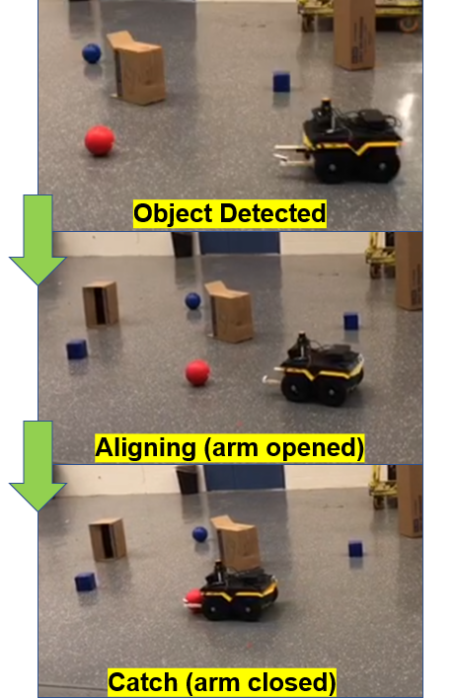
Catching & Navigation Testing

Slide 12
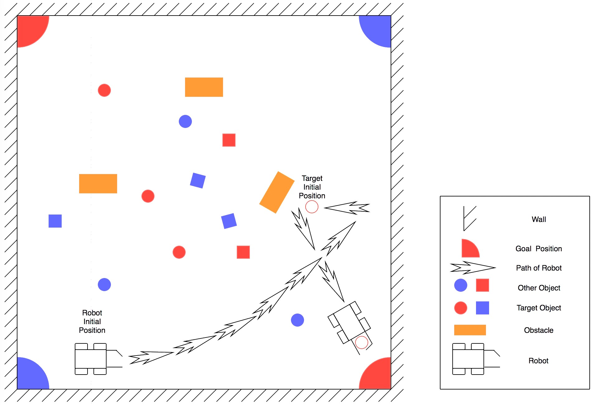
Mission FSM Testing
Field Setup
Mission
Taking red balls to red corner
Taking blue boxes to red corner
Taking blue balls to blue corner

Slide 13
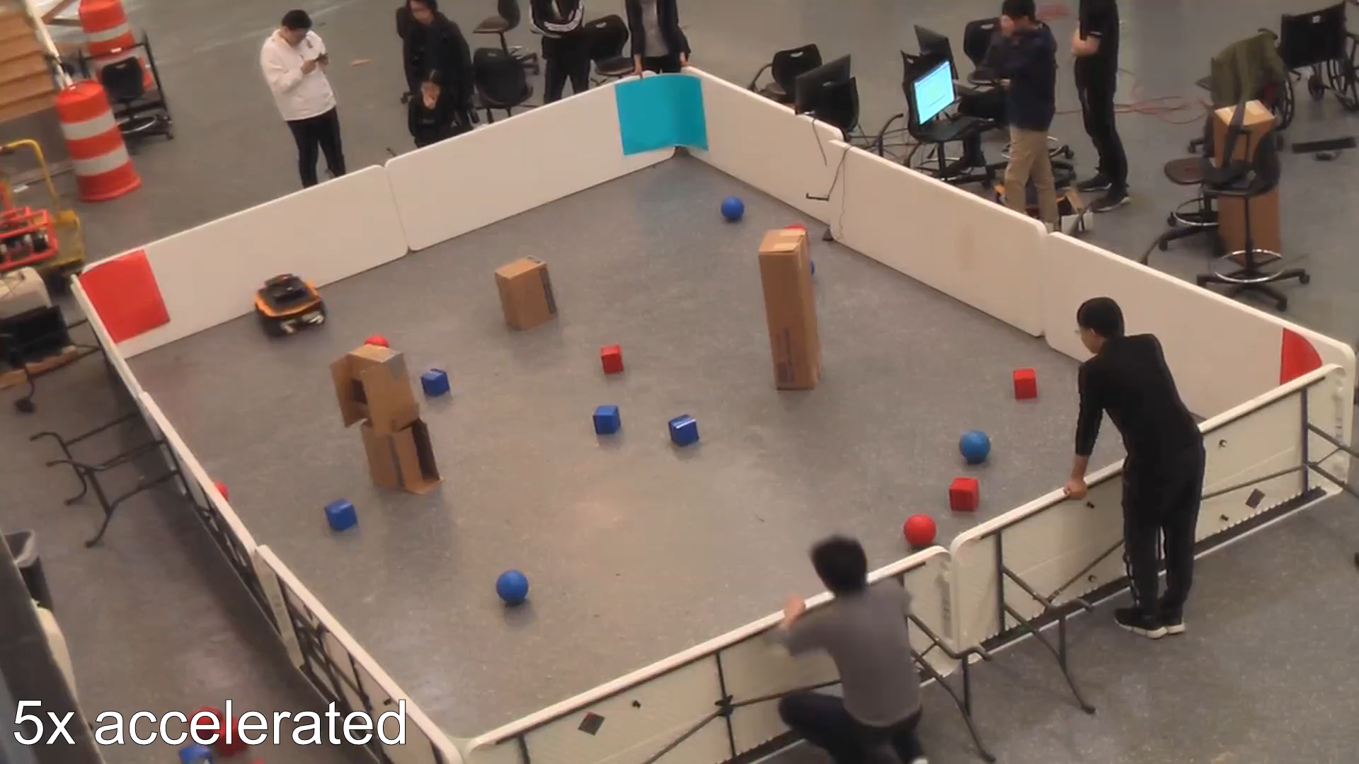
Mission FSM Testing

Slide 14
Thank You

